Slide 1
Project presentation ——Group 1
Credit Card Default Prediction & Analysis

Slide 2
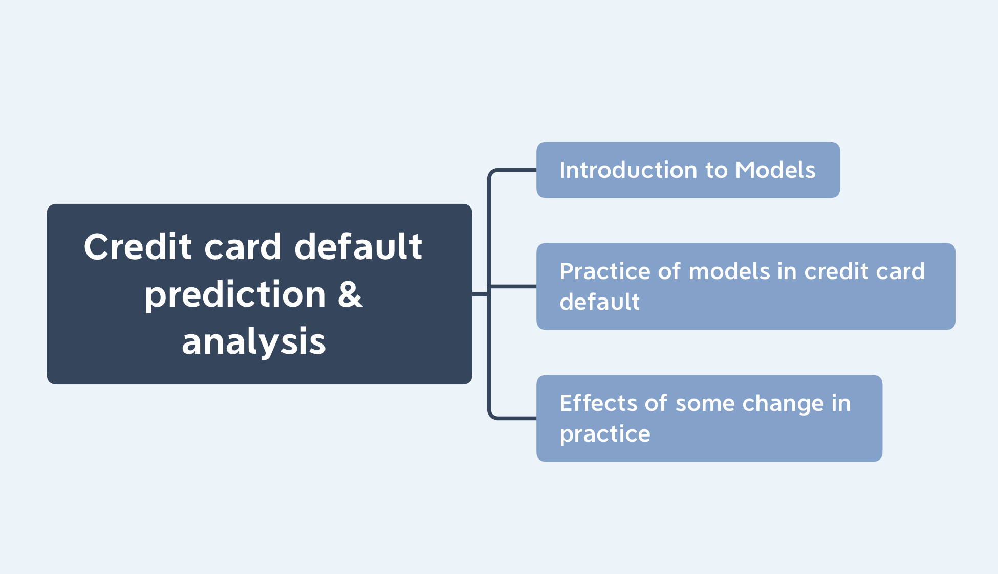
Outline

Slide 3
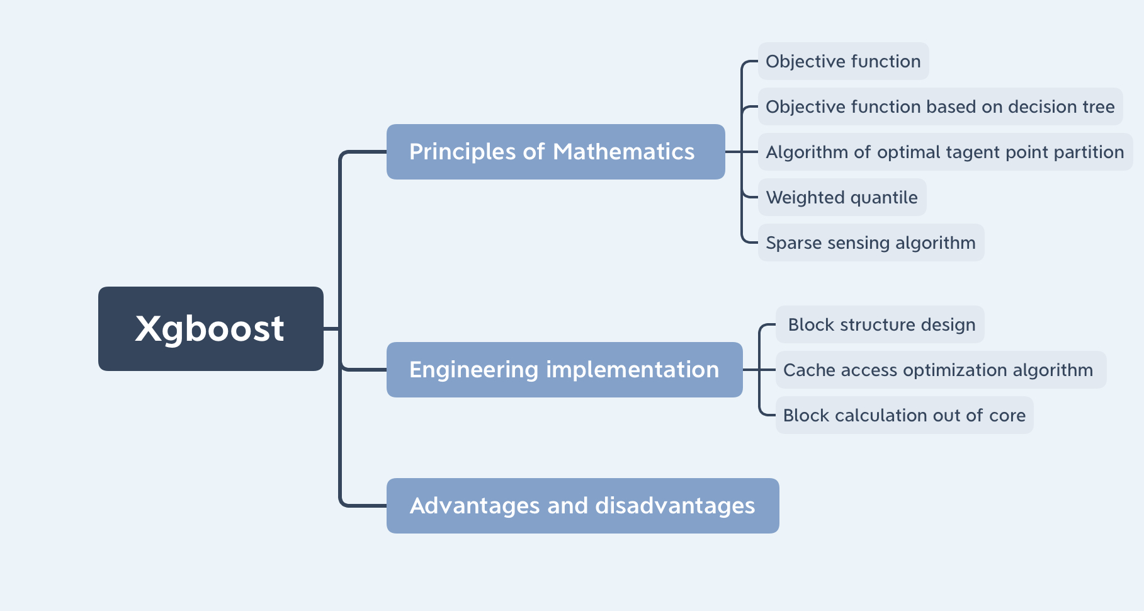
Model Introduction
Xgboost

Slide 4
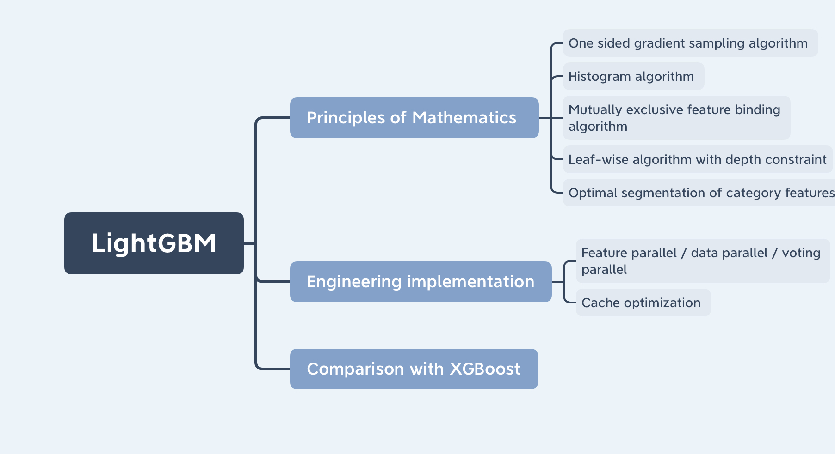
Model Introduction
Lightgbm
thought.
thought
thought

Slide 5
Preprocessing
Data
Missing value: Null, NaN, Inf…
Categorical values: encoding scheme…
Unbalanced dataset: resample…

Slide 6
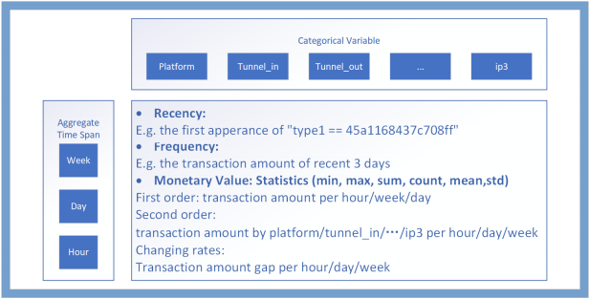
Feature Engineering
RFM Model
Tracking user’s Recency, Frequency, Monetary Value

Slide 7
Feature Selection
Choose Top 100 Features
Delete the features that 99.9% of the values are concentrated in the same value
Lightgbm model is used to train the remaining features, from which the top 100 importance are selected through cross validation

Slide 8
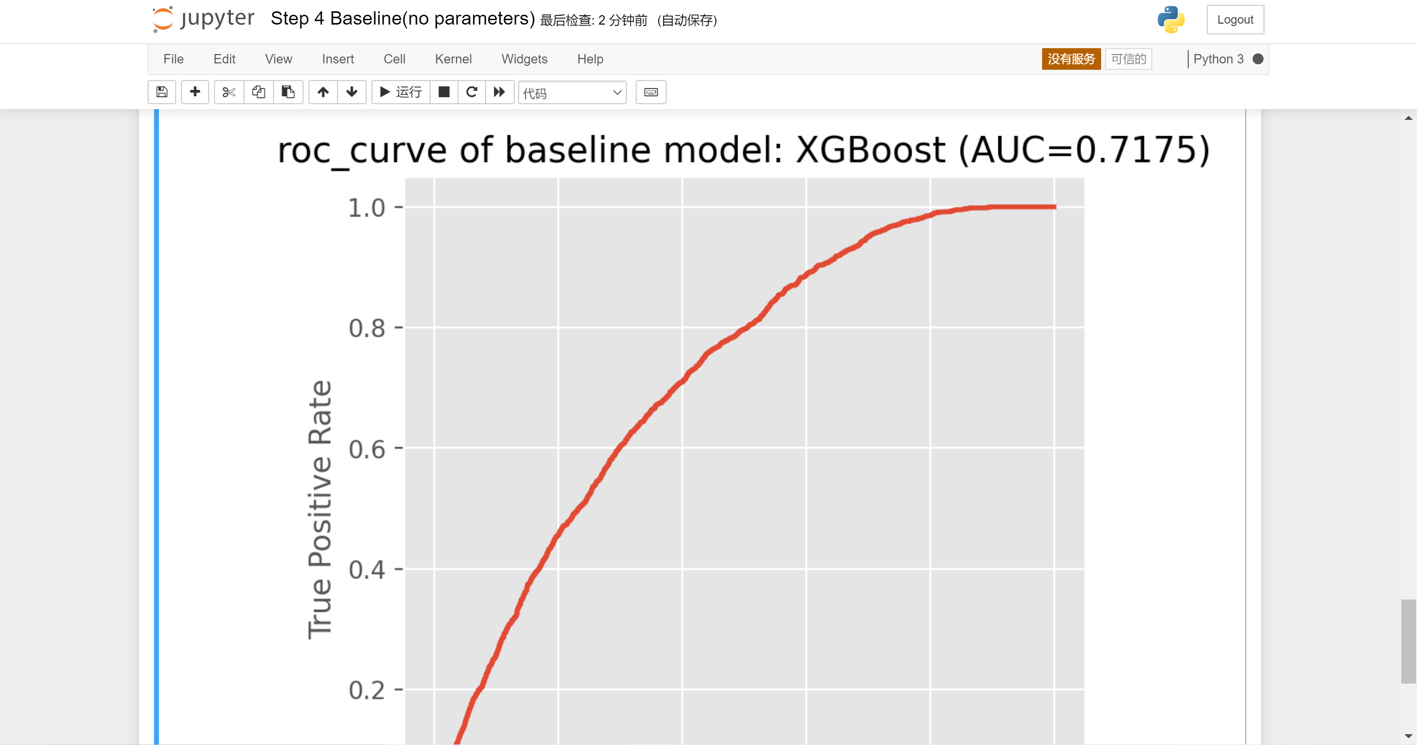
Model Training – Baseline
Xgboost.
The model is trained without parameters.

Slide 9
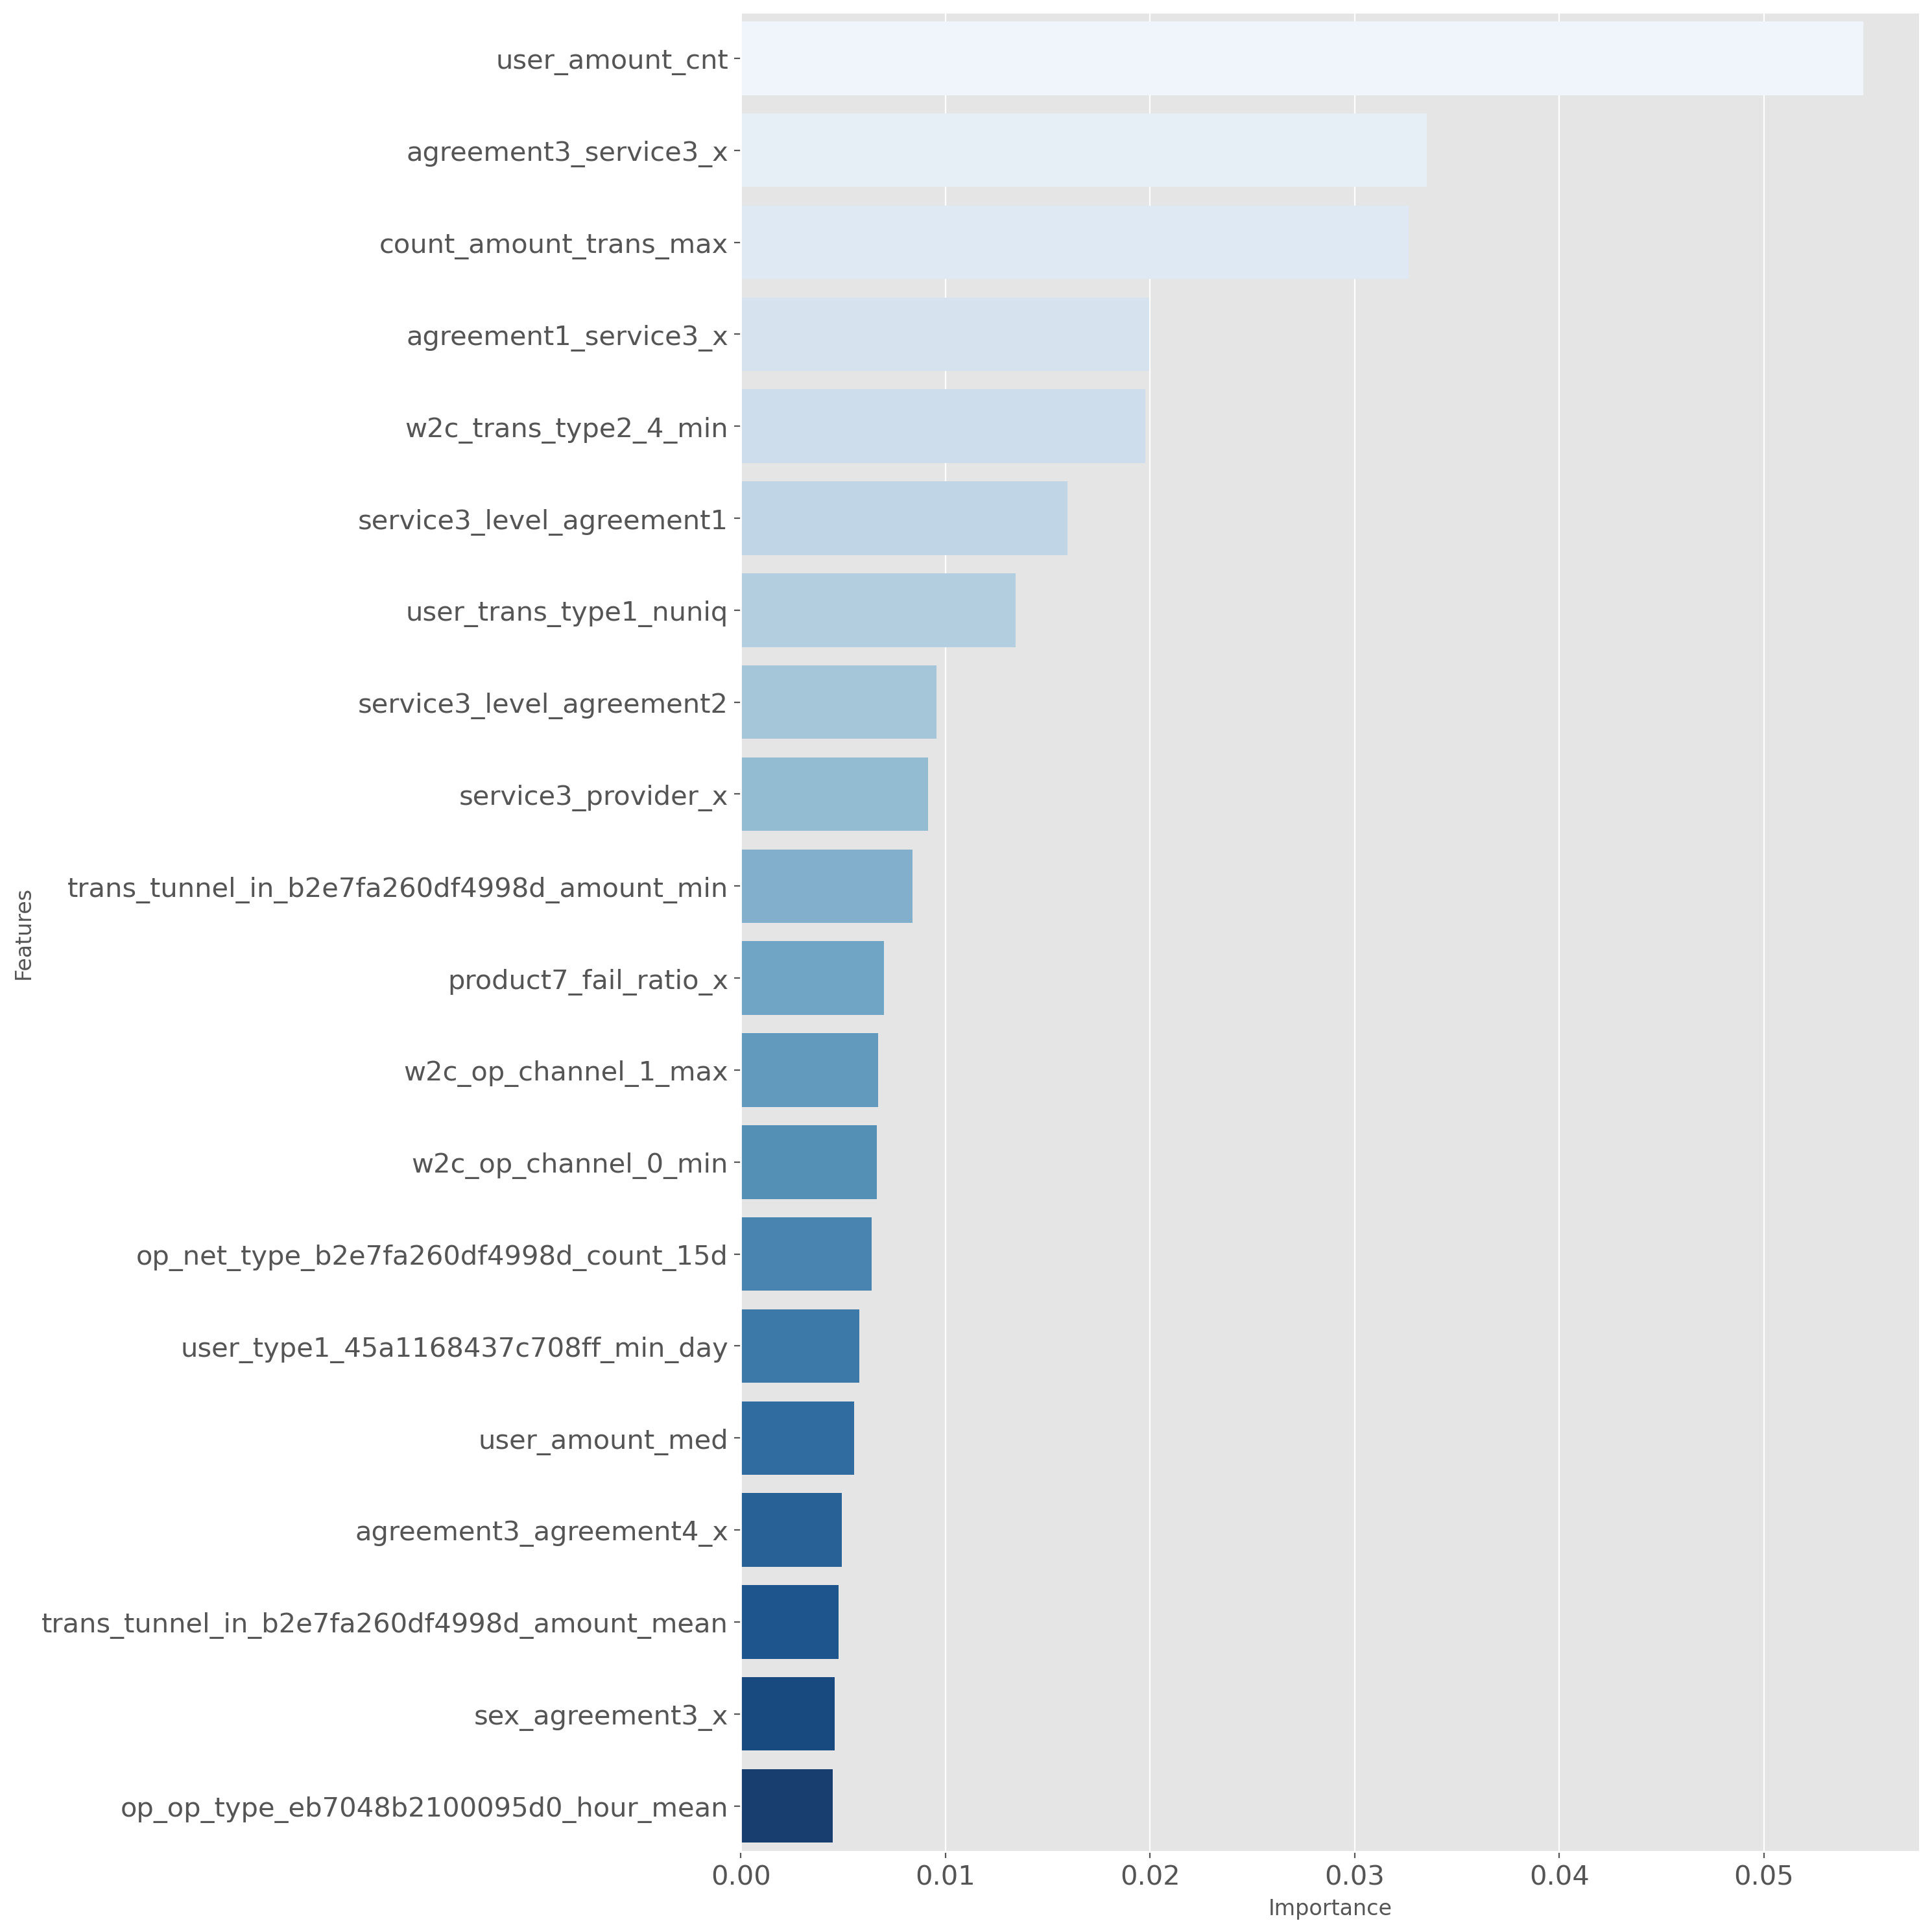
Model Training – Baseline
Xgboost.
Top importance of its feature.

Slide 10
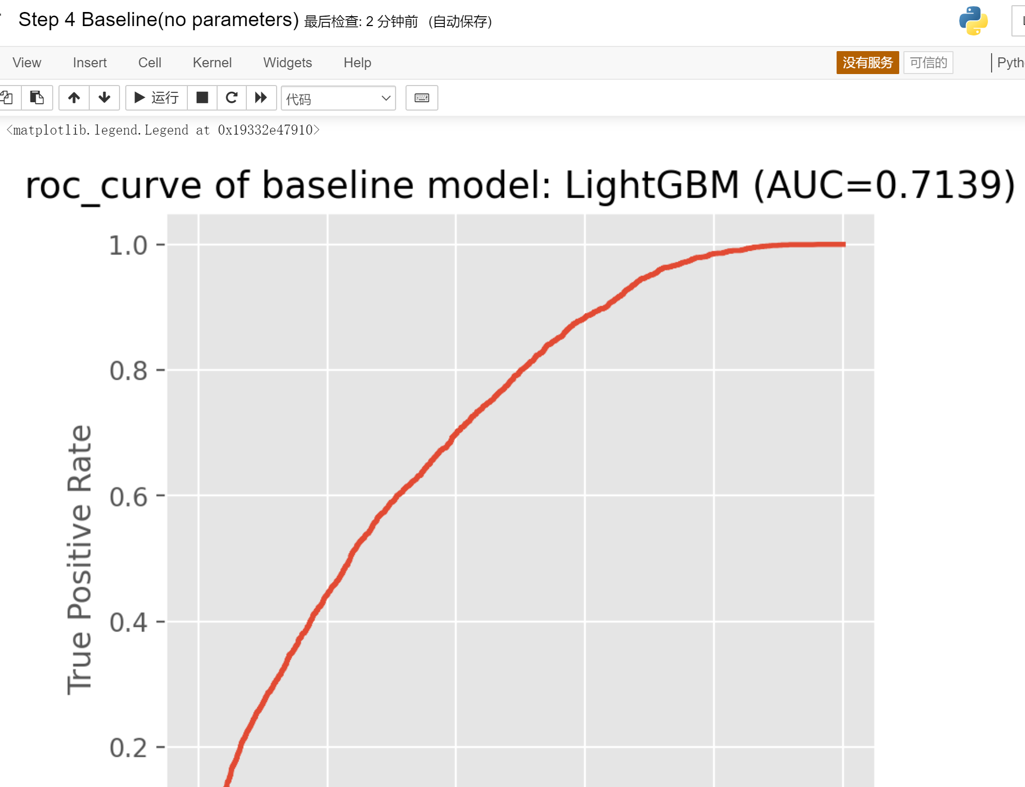
Model Training – Baseline
Lightgbm.
The model is trained without parameters.

Slide 11
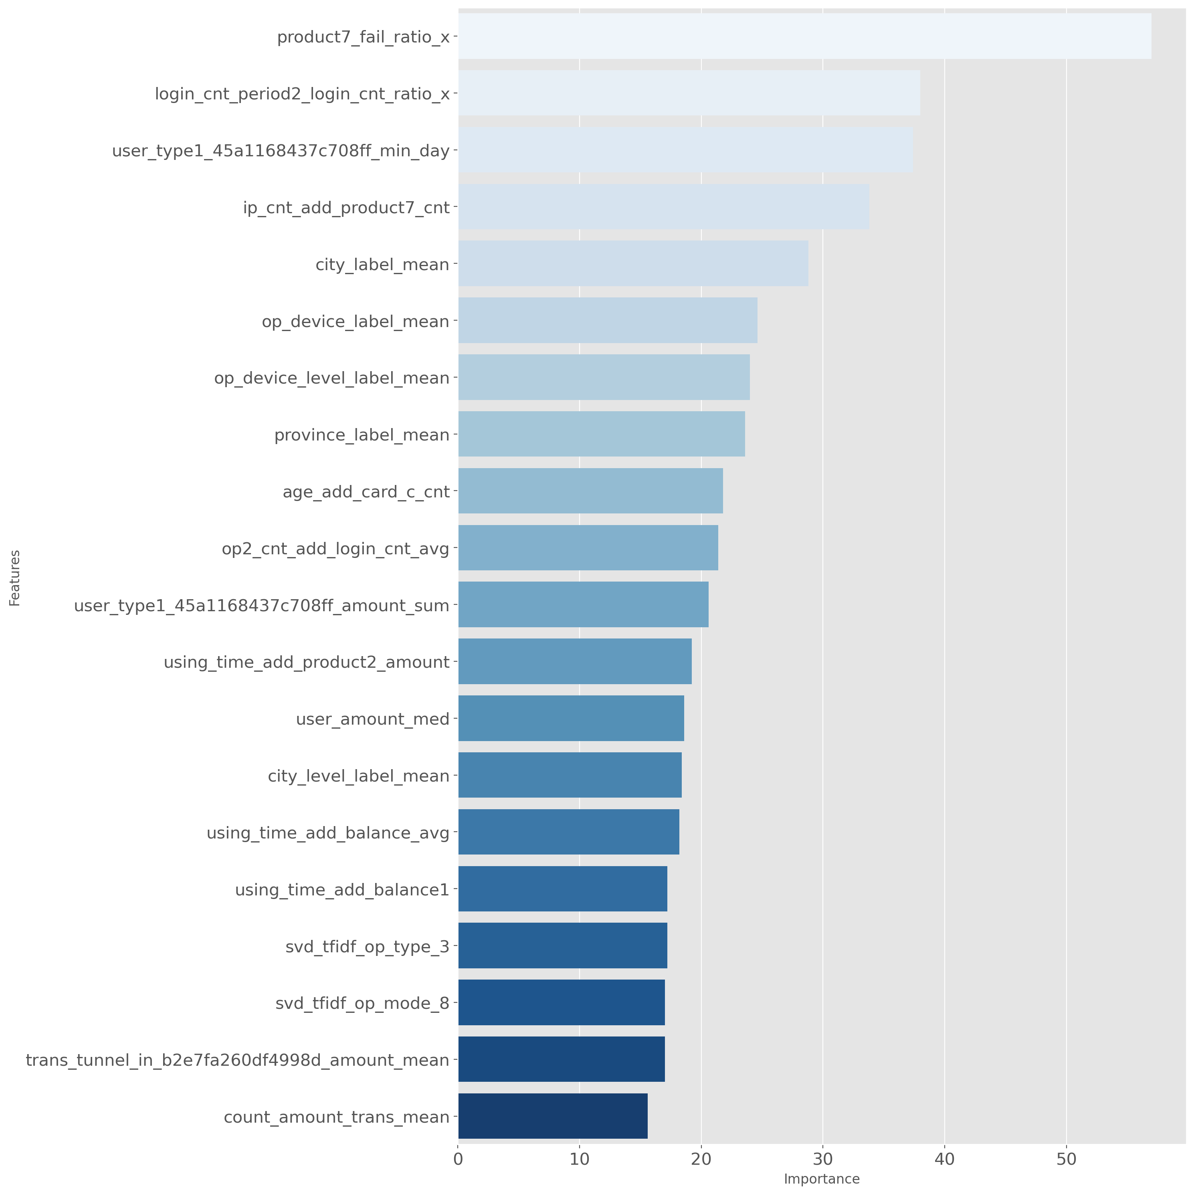
Model Training – Baseline
Lightgbm.
Top importance of its feature.
Several features are the same, indicating the importance of service development.

Slide 12
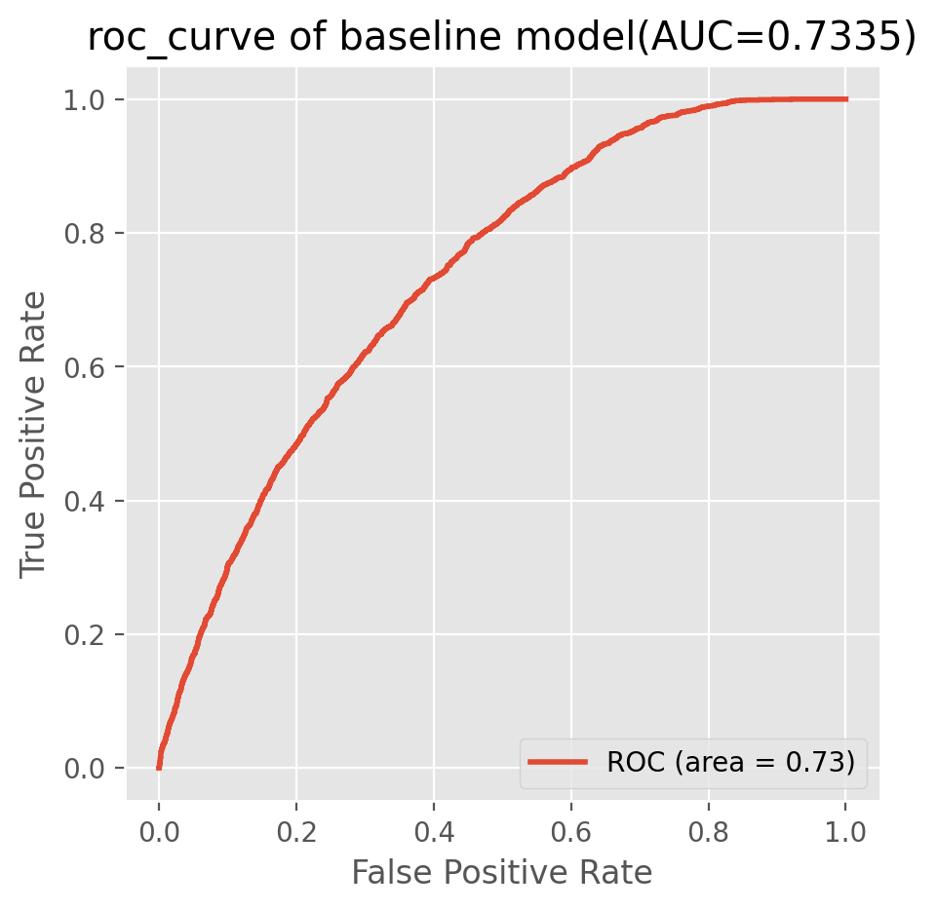
Model Training – Opt. Params.
Xgboost.
Optimal parameters are obtained by adjusting the parameters
The model is trained by cross validation, and the results are referential

Slide 13
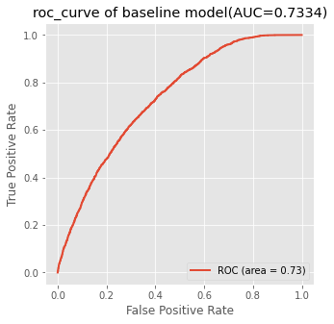
Model Training – Opt. Params.
Lightgbm.
Optimal parameters are obtained by adjusting the parameters
The model is trained by cross validation, and the results are referential

Slide 14
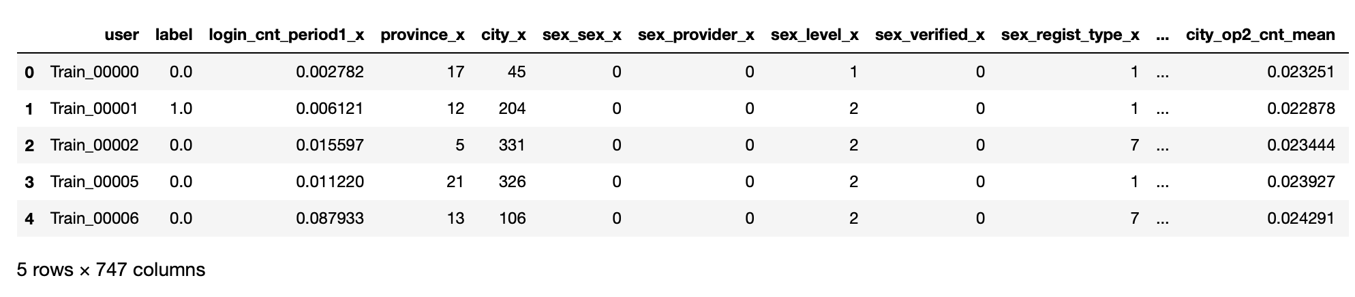
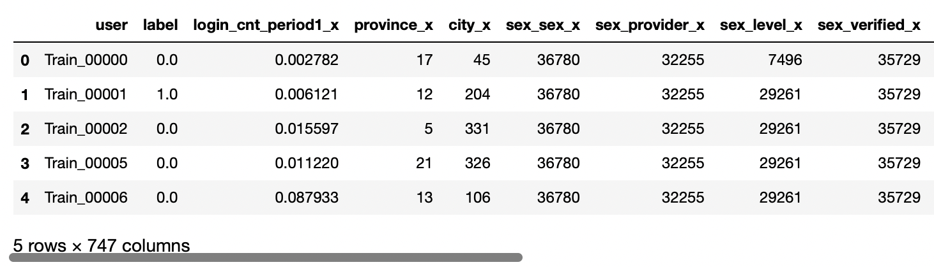
Model Training – Change Encoder
Label Encoder (default)
Replace each categorical value with a unique value
Count Encoder
Replace each categorical value with its number of appearance

Slide 15
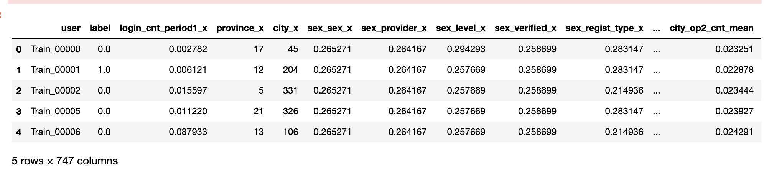
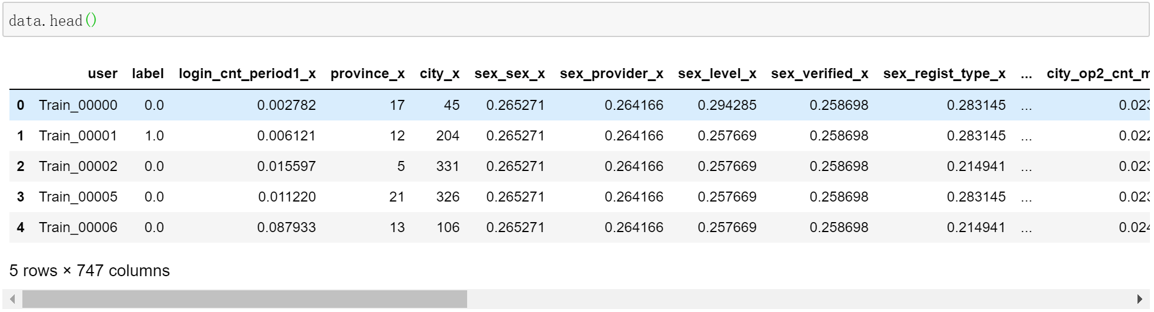
Model Training – Change Encoder
Target Encoder
Replace each categorical value with the average value of the target for that value of the feature
Catboost Encoder
Similar to target encoder, target probability is calculated only from the rows before each categorical value

Slide 16
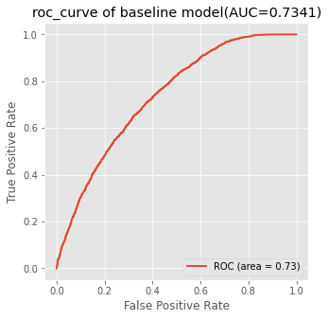

Make a change
Encoder change
Count Encoder
Comparison
AUC is also high
LGB
XGB

Slide 17
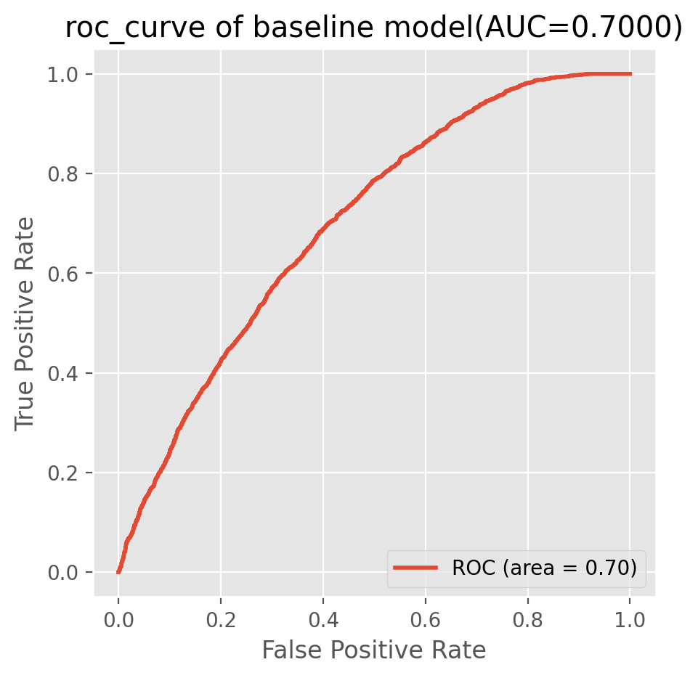
Make a change
Encoder change
Target Encoder
Comparison
AUC is declined to some extent
LGB
XGB

Slide 18
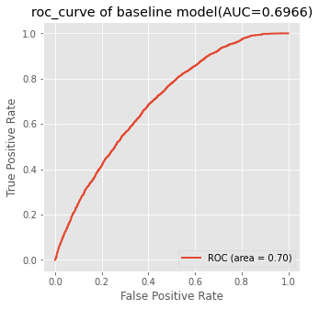
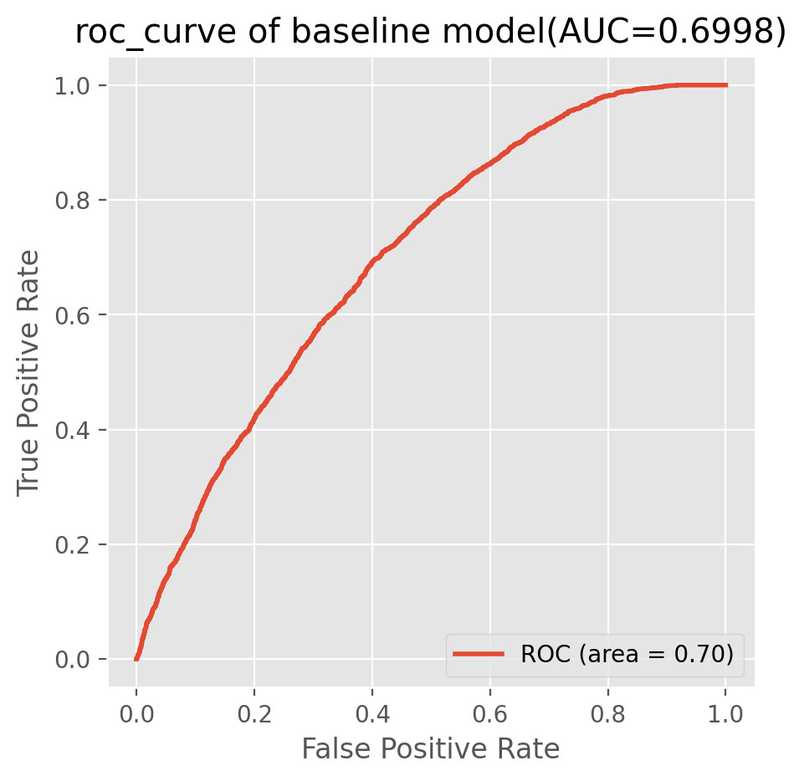
Make a change
Encoder change
Catboost Encoder
Comparison
AUC is declined to some extent
LGB
XGB

Slide 19
Make a change
Encoder change
After comparing all the feature importance:
For xgb model, no feature importance is particularly stable
For lgb model, Product 7 fail feature is quite important in all the practice

Slide 20
Make a change
Sampling
Purpose
Adjust the training set
Eg. let the model learn the parameters in a balanced sample environment, and then do the prediction on the unbalanced data set

Slide 21
Make a change
Sampling
Find a sampling method making lgb model performs better
Smote Tomek method is used to oversampling a balanced training set, and then undersampling a balanced test set

Slide 22
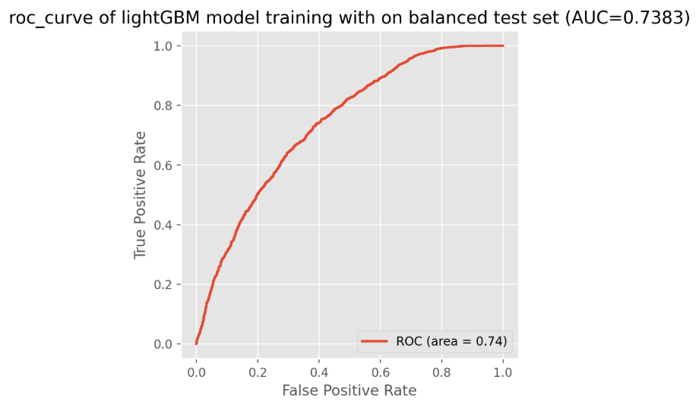
Make a change
Sampling
Method result:
AUC increases a bit

Slide 23
THANK YOU

